Slide 1
ECE408 / CS483
Applied Parallel Programming
Lecture 18: Final Project Kickoff

Slide 2
Objective
To Build up your ability to translate parallel computing power into science and engineering breakthroughs
  Identify applications whose computing structures are suitable for massively parallel execution
  10-100X more computing power can have transformative effect on these applications
  You have access to expertise/knowledge needed to tackle these applications
Develop algorithm patterns that can result in both better efficiency as well as scalability
  To share with the community of application developers

Slide 3
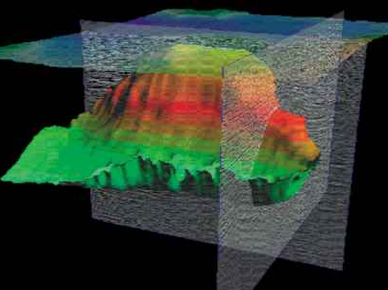
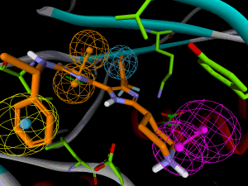
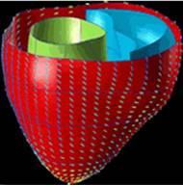
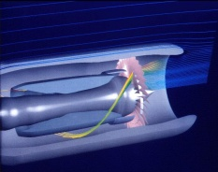
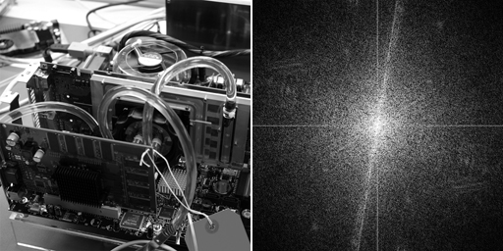

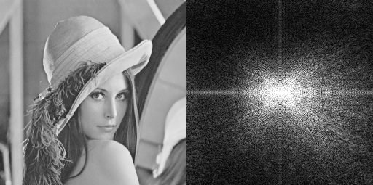
Future Science and Engineering Breakthroughs Hinge on Computing
Computational
Geoscience
Computational
Chemistry
Computational
Medicine
Computational
Modeling
Computational
Physics
Computational
Biology
Computational
Finance
Image
Processing
Notes:
computational is the third leg of science – joining theory and experimentation
replaces Edisonian method

Slide 4

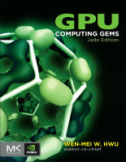
GPU computing is catching on.

Slide 5
GPU computing is catching on.
Financial Analysis
Scientific Simulation
Engineering Simulation
Data Intensive Analytics
Medical Imaging
Digital Audio Processing
Digital Video Processing
Computer Vision
Biomedical Informatics
Electronic Design Automation
Statistical Modeling
Ray Tracing Rendering
Interactive Physics
Numerical Methods
280 submissions to GPU Computing Gems
  ~90 articles included in two volumes

Slide 6
A major shift of paradigm
In the 20th Century, we were able to understand, design, and manufacture what we can measure
  Physical instruments and computing systems allowed us to see farther, capture more, communicate better, understand natural processes, control artificial processes…
In the 21st Century, we are able to understand, design, create what we can compute
  Computational models are allowing us to see even farther, going back and forth in time, relate better, test hypothesis that cannot be verified any other way, create safe artificial processes

Slide 7
Examples of Paradigm Shift
20th Century
Small mask patterns and short light waves
Electronic microscope and Crystallography with computational image processing
Anatomic imaging with computational image processing
Teleconference
21st Century
Computational optical proximity correction
Computational microscope with initial conditions from Crystallography
Metabolic imaging sees disease before visible anatomic change
Tele-emersion

Slide 8
Faster is not “just Faster”
2-3X faster is “just faster”
  Do a little more, wait a little less
  Doesn’t change how you work
5-10x faster is “significant”
  Worth upgrading
  Worth re-writing (parts of) the application
100x+ faster is “fundamentally different”
  Worth considering a new platform
  Worth re-architecting the application
  Makes new applications possible
  Drives “time to discovery” and creates fundamental changes in Science

Slide 9
How much computing power is enough?
Each jump in computing power motivates new ways of computing
  Many apps have approximations or omissions that arose from limitations in computing power
  Every 10x jump in performance allows app developers to innovate
  Example: graphics, medical imaging, physics simulation, etc.
Application developers do not take it seriously until they see real results.

Slide 10
Why didn’t this happen earlier?
Computational experimentation is just reaching critical mass
  Simulate large enough systems
  Simulate long enough system time
  Simulate enough details
Computational instrumentation is also just reaching critical mass
  Reaching high enough accuracy
  Cover enough observations

Slide 11
A Great Opportunity for Many
New massively parallel computing is enabling
  Drastic reduction in “time to discovery”
  1st principle-based simulation at meaningful scale
  New, 3rd paradigm for research: computational experimentation
The “democratization” of power to discover
    $2,000/Teraflop in personal computers today
    $5,000,000/Petaflops in clusters today
    HW cost will no longer be the main barrier for big science
This is once-in-a-career opportunity for many!
Notes:
Mention Petascale, ECE498AL, and IACAT

Slide 12
The Pyramid of Parallel Programming
Thousand-node systems with MPI-style programming, >100 TFLOPS, $M, allocated machine time (programmers numbered in hundreds)
Hundred-core systems with CUDA-style programming, 1-5 TFLOPS, $K, machines widely availability (programmers numbered in 10s of thousands)
Hundred-core systems with MatLab-style programming, 10-50 GFLOPS, $K, machines widely available (programmers numbered in millions)

Slide 13
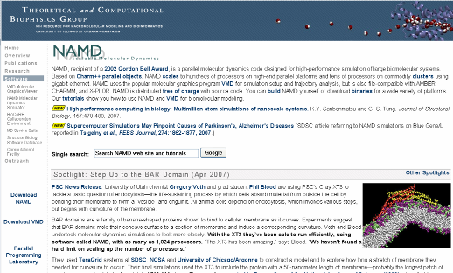
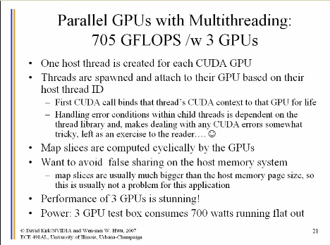
VMD/NAMD Molecular Dynamics
240X speedup over sequential code
Computational biology
http://www.ks.uiuc.edu/Research/vmd/projects/ece498/lecture/

Slide 14
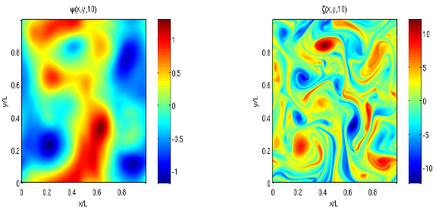
Matlab: Language of Science
15X with MATLAB CPU+GPU
http://developer.nvidia.com/object/matlab_cuda.html
Pseudo-spectral simulation of 2D Isotropic turbulence
http://www.amath.washington.edu/courses/571-winter-2006/matlab/FS_2Dturb.m

Slide 15
Prevalent Performance Limits
Some microarchitectural limits appear repeatedly across the benchmark suite:
Global memory bandwidth saturation
  Tasks with intrinsically low data reuse, e.g. vector-scalar addition or matrix-vector multiplication product
  Computation with frequent global synchronization
    Converted to short-lived kernels with low data reuse
    Common in simulation programs
Thread-level optimization vs. latency tolerance
  Since hardware resources are divided among threads, low per-thread resource use is necessary to furnish enough simultaneously-active threads to tolerate long-latency operations
  Making individual threads faster generally increases register and/or shared memory requirements
  Optimizations trade off single-thread speed for exposed latency

Slide 16
What you will likely need to hit hard.
Parallelism extraction requires global understanding
  Most programmers only understand parts of an application
Algorithms need to be re-designed
  Algorithmic effect on parallelism and locality is often hard to maneuver
Real but rare dependencies often need to be pushed aside
  Error checking code, etc., parallel code is often not equivalent to sequential code
Getting more than a small speedup over sequential code is very tricky
  ~20 versions typically experimented for each application

Slide 17
Parboil Benchmarks – Code Example Resources for Your Project
Collections of best parallel programming projects for heterogeneous CPU/GPU computing
  Sequential code
  Generic parallel code
  Highly optimized parallel code for various systems
http://impact.crhc.illinois.edu/parboil.php

Slide 18
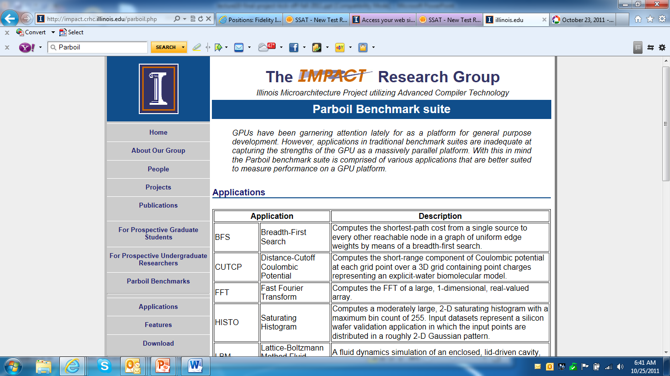
Parboil Benchmarks Home Page

Slide 19
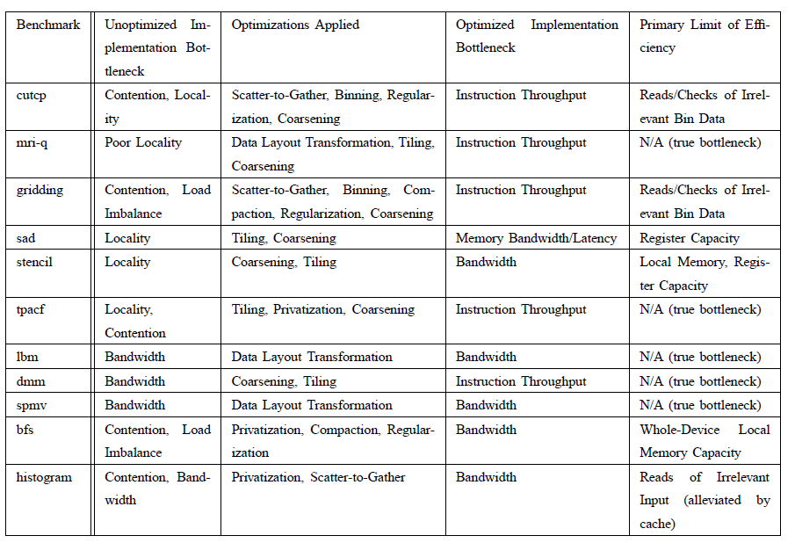
Use of Optimizations in Parboil

Slide 20
Call to Action
One page project description due October 29, 2012
  Introduction: A one paragraph description of the significance of the application.
  Description: A one to two paragraph brief description of what the application really does
  Objective: A paragraph on what the mentor would like to accomplish with the student teams on the application.
  Background : Outline the technical skills (particular type of Math, Physics, Chemstry courses) that one needs to understand and work on the application.
  Resources: A list of web and traditional resources that students can draw for technical background, general information and building blocks. Give URL or ftp paths to any particular implementation and coding examples.
  Contact Information: Name, e-mail, and perhaps phone number of the person who will be mentoring the teams working on the application.
Several “workshop” lectures dedicated to presentation of project ideas to recruit teams/teammates.
http://courses.engr.illinois.edu/ece408/fall2011/ece408_projects.html

Slide 21
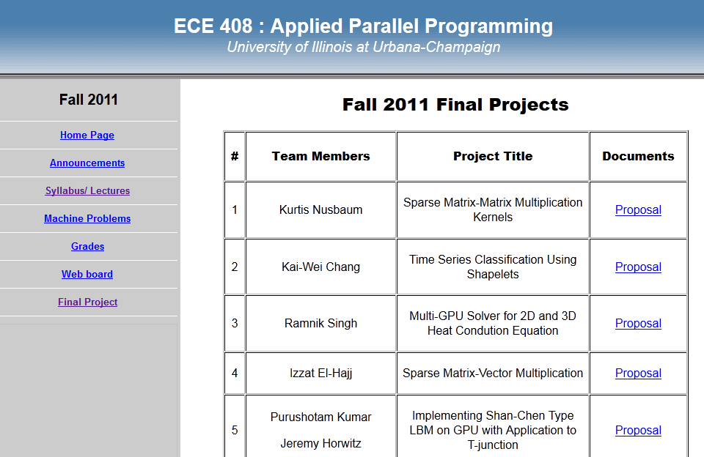
Some Previous Proposal Examples

Slide 22
ECE408/CS483 Fall 2012
Parallel Programming Competition
Sponsored by MulticoreWare, contact Steve Borho
Can be used as final project, or you can do both
2-3 people per team, iPad for each winning team member
Competition problem will be announced by October 31.

Slide 23
Any More Questions?

